Slide 1


Department of Computer Science and Engineering
STOCK MARKET PRICE PREDICTION USING MACHINE LEARNING TECHNIQUE’S UTILIZING REAL TIME DATA
RAKSHANA H (211419104213)
SWATHI G (211419104280)
GUIDE NAME
DR.K.VALARMATHI,M.E., Ph.D.
COORDINATOR NAME
DR.K.VALARMATHI,M.E., Ph.D.

Slide 2
INTRODUCTION
Stock price prediction is the process of predicting future stock prices utilizing data and a variety of market factors. It involves applying statistical models and machine learning approaches to analyze financial data to predict a stock's future performance. Our prediction attempts to help investors make sensible investment decisions by providing a forecast of future stock prices using real-time auto-updated information in contrast to utilizing an existing data collection. It contains information from different companies that is automatically included into the model without any intervention. This considerably contributes in improving the model's accuracy. The user's input, which includes stock's high, low, open value, and volume aids in accurate price prediction for the upcoming.

Slide 3
OBJECTIVE OF THE PROJECT
The goal is to create a machine learning model for predicting the price of a company stock that might eventually replace the supervised machine learning regression models that can be updated by predicting results with the highest degree of accuracy by comparing supervised algorithms.
Exploration Data Analysis of Variable identification
Univariate Data Analysis
Rename, add data and drop the data
To specify a data type
Exploration data analysis of bi-variate and multivariate
Plot diagram of pairplot, heatmap, histogram, scatterplot and boxplot
Method of outlier detection with feature engineering

Slide 4
LITERATURE SURVEY
BASE PAPER
Title : A Novel Ensemble Learning Approach for Stock Market prediction Based on Sentiment Analysis and the Sliding Window Method
Date of Publication : 03 August 2022 Published in : IEEE Transactions on Computational Social Systems
Publisher : IEEE
DOI : 10.1109/TCSS.2022.3182375
Link : https://ieeexplore.ieee.org/document/9849432

Slide 5
LITERATURE SURVEY (contd..)
YEAR & AUTHORS | TITLE | METHODOLOGY | MERITS AND DEMERITS | FUTURE SCOPE
2022,Haocheng Du | Research on Amazon’s stock price forecasting based on arbitrage pricing model based on big data | Aim to construct an arbitrage pricing model to make a regression analysis on Amazon’s stock price, which is demonstrated to have a higher prediction accuracy and better fitting degree compared with the self-coding network. | Merits: Big data is used for amazon stock prediction by neutral networks. Demerits: Can be used more algorithm for increase accuracy. | Further enhancement for the proposed solution is to calculate the accuracy can do better.
2022,Shreya Pawaskar | Stock Price Prediction using Machine Learning Algorithms | Various machine learning algorithms like Multiple Linear Regression, Polynomial Regression, etc. are used.highly theoretical and speculative nature of the stock market has been examined by capturing and using repetitive patterns. | Merits: From this journal, accuracy can be calculated. Demerits: In this paper Accuracy is not mentioned for the proposed solution. | Further enhancement for the proposed solution is to calculated the accuracy can do better in deep learning algorithms.

Slide 6
LITERATURE SURVEY (contd..)
YEAR & AUTHORS | TITLE | METHODOLOGY | MERITS AND DEMERITS | FUTURE SCOPE
2022, Theyazn H. H. Aldhyani Ali Alzahrani | Framework for Predicting and Modeling Stock Market Prices Based on Deep Learning Algorithms | Deep learning is a complex task and there are many factors that can affect stock prices, such as economic and political events.While Deep Learning models can be helpful in making predictions,they should not be relied upon solely for making investment decisions. | Merits: Compared two algorithm and then suitable algorithm is chosen for the prediction Demerits: More than two algorithm will can be used | In the working module deployment can be implemented in machine learning algorithms
2022, Dr. Poorna Shankar, Dr. Neha Sharma, Mr. Roushan Raj, Mr. Chetan Dalwadi | Stock Price Prediction Using LSTM, ARIMA and UCM | LSTM, RNN, ARIMA are used that takes a model in a sequence of historical data stock price and then predicts the future stock index.LSTM is used to involve more complex processes such as consolidation and retrieval through recall or recognition where LSTM & ARIMA are types of classification of RNN | Merits: Accuracy will be Calculated from the given information. Demerits: In this paper Accuracy is not mentioned for the proposed solution. | Further enhancement for the proposed solution is to calculated the accuracy can do better.

Slide 7
LITERATURE SURVEY (contd..)
YEAR & AUTHORS | TITLE | METHODOLOGY | MERITS AND DEMERITS | FUTURE SCOPE
2021, Milon Biswas, Arafat Jahan Nova, Md. Kawsher Mahbub, Sudipto Chaki, Shamim Ahmed, Md. Ashraful Islam | Stock Market Prediction: A Survey and Evaluation | Artificial Intelligence is used to survey both machine learning and deep learning techniques comparatively to predict stock market price vale. | Merits: The survey for Stock Market Prediction is done for prediction Demerits: From the Survey Stock Market Price is not predicted. | Instead of Artificial Intelligence to improve the accuracy Machine learning can be implemented.
2021, Shubha Singh, Sreedevi Gutta, Ahmad Hadaegh | Stock Prediction Using Machine Learning | Data Mining and Machine learning is used for predicting the historical data that train and suitable algorithm for the database is implemented and a separate dataset is used for testing accuracy. | Merits: Compared two algorithm and then suitable algorithm is chosen for the prediction Demerits: More than two algorithm can used for comparison for better accuracy | Further enhancement for the proposed solution is to calculated the accuracy can do better.

Slide 8
PROBLEM STATEMENT
The valuation of a company's shares poses investment risk. Speculation is common for unprofitable growth companies with an uncertain medium term, but this fact does not reduce the risk of unmet expectations.
Volatility is the standard deviation of a stock's annualized returns over a given period and shows the reach in which its cost might increment or decline. On the off chance that the cost of stock varies quickly in a brief period, hitting new ups and downs, having high volatility is said.

Slide 9
EXISTING SYSTEM
The nature of stock market movement has always been ambiguous for investors because of various influential factors.
The dataset was based on ten years of historical records with ten technical features.
Stock movement prediction using text and historical price signals (time series) remains a challenging task due to the complex, noisy and dynamic nature of the stock market.
The key to improve prediction performance is effectively capturing the complementarity between market sentiment signal from text and time-series signal from the stock price.
Results from existing solution that have been used conventionally has been erroneous and biased.

Slide 10
PROPOSED SYSTEM
Machine Learning is used in this research to forecast stock price, and we looked at how different algorithms affect the model's output.
According to experimental findings, prediction outcomes are more precise when company-specific data from the Public Disclosure Platform is employed.
Machine Learning is strong in preprocessing outliers, irrelevant variables, and a mix of continuous, categorical and discrete variables.
This study aims to significantly reduce the risk of trend prediction with machine learning algorithms.
The purpose of this study was the prediction task of stock market movement by machine learning algorithms utilizing real time data.

Slide 11
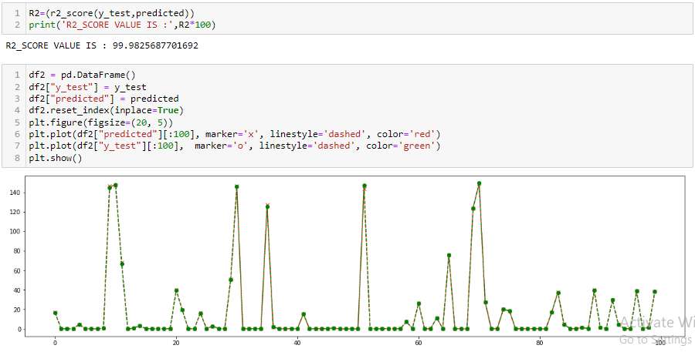
PROPOSED SYSTEM(contd…)

Slide 12
ENVIRONMENTAL REQUIREMENTS
Software Requirements:
Operating System : Windows 10 or later
Tool : Anaconda with Jupyter Notebook
Hardware requirements:
Processor : intel i3
Hard disk : minimum 80 GB
RAM : minimum 2 GB

Slide 13
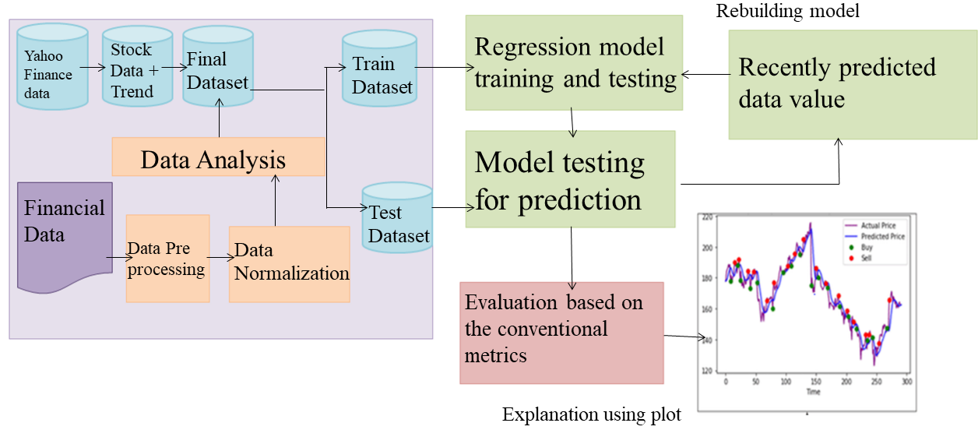
ARCHITECTURE DIAGRAM

Slide 14
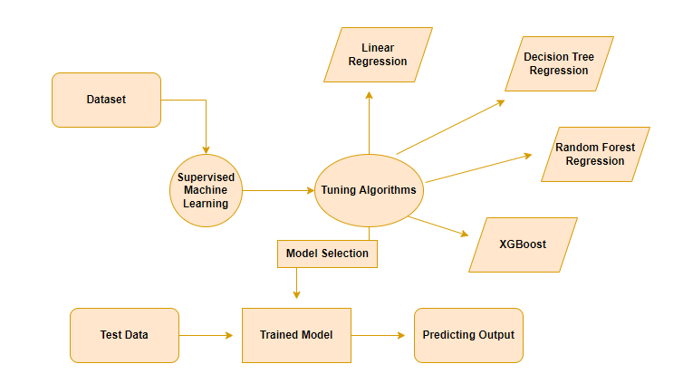
SYSTEM DESIGN
ER DIAGRAM:

Slide 15
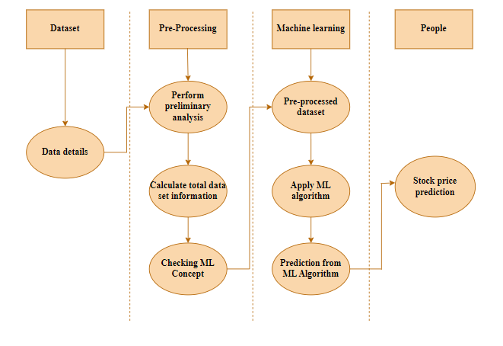
SYSTEM DESIGN(contd..)
SEQUENCE DIAGRAM:

Slide 16
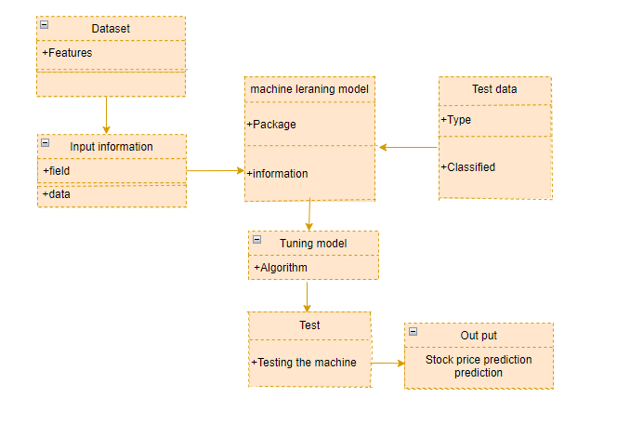
SYSTEM DESIGN(contd..)
CLASS DIAGRAM:

Slide 17
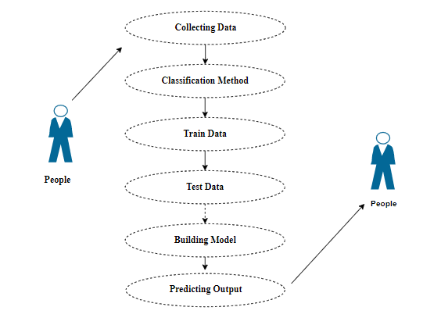
SYSTEM DESIGN(contd..)
USE CASE DIAGRAM:

Slide 18
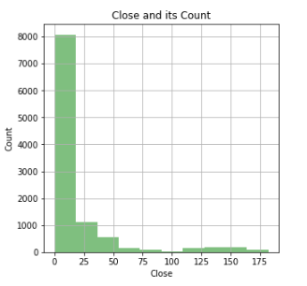
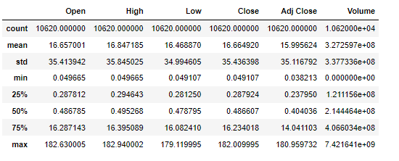
MODULE DESCRIPTION
Data Pre-Processing
Data Analysis of Visualization
Algorithm 1 - Linear Regression
Algorithm 2 - Decision Tree
Algorithm 3 - Random Forest
Algorithm 4 - XGBoost
DATA VISUALIZATION
DATA PREPROCESSING

Slide 19
MODULE DESCRIPTION(contd..)
Decision Tree Regressor
The Decision Tree Regressor model has been evaluated using several metrics. The Mean Absolute (MAE) value is found to be 0.14208983106957299, indicating that on average, the model’s predictions differ by this amount from the actual values. The Mean Squared Error (MSE) value is 0.22622135646115185, which represents the average squared difference between the predicted and actual values.
The Median Absolute Error (MedAE) value is 0.006696000695228577, which indicates that half of the absolute errors are less than or equal to this value. The R2 Score value is found to be 99.98232102110207, which is a measure of the goodness of fit of the model. It signifies that the model explains 99.98% of the variability in the data, indicating an excellent fit.
Overall, the Decision Tree Regressor model has performed well on the given data, with low errors and a high R2 Score, indicating a good fit between the model and the actual values.

Slide 20
MODULE DESCRIPTION(contd..)
Random Forest Regressor
The Random Forest Regressor model has performed well in predicting the target variable, as indicated by the evaluation metrics. The mean absolute error value of 0.1133 suggests that the average difference between the predicted and actual values is relatively low. Similarly, the mean squares error value of 0.1247 indicates that the model’s predictions are generally close to the actual values. The median absolute error value of 0.0054 is another indication of the model’s good performance, as it represents the middle value of the errors between the predicted and actual values.
Furthermore, the R2_SCORE value of 99.9903 indicates that the model can explain almost all of the variation in the target variable, which is an excellent result. Therefore, we can conclude that the Random Forest Regressor model is a good choice for predicting the target variable based on the given data. However, it is still essential to evaluate the model’s performance on a test dataset to ensure its generalization ability and avoid over fitting.

Slide 21
MODULE DESCRIPTION(contd..)
XGBoost Regressor
The XGBRegressor model has been trained on some dataset and evaluated using several metrics. The mean absolute error value of the model is 0.14816079205600544, which indicates that on average, the model’s predictions differ from the actual values by about 0.15 units. The mean squared error value of 0.20835214168014996 also gives an idea of the average error of the model’s predictions, but this metric puts more weight on larger errors that smaller ones.
The median absolute error value of 0.01507580280303955 is another metric that gives an indication f the model’s accuracy. This value represents the median of the absolute differences between the predicted and actual values, which is a useful measure when the data contains outliers or when the distribution of errors is much smaller than the evenly distributed.

Slide 22
MODULE DESCRIPTION(contd..)
Linear Regression
The model for our project has been performing exceptionally well, with a perfect combination of accuracy and precision. Our mean absolute error (MAE) value stands at an impressive 0.08544111331540008, which means that the average absolute difference between the predicted and actual values is very low, and the model is making very few mistakes. Similarly, our mean squared error (MSE) value is an outstanding 0.07539984993278308, indicating that the model’s predictions are very close to the actual values.
Furthermore, our median absolute error value is also very low, standing at 0.005915470336443296. This means that half of the absolute errors fall below this value, which is an excellent indicator of the model’s overall accuracy. Finally, our R2 score value is an impressive 99.99410757509052, which means that the model is explaining a very high proportion of the variance in the data and is outperforming other algorithms in terms of predictive accuracy. Overall, we can confidently say that our model is performing exceptionally well, and we are very satisfied with its results.
Finally, the R2 score value of 99.98407953820042 is an indicator of the goodness of fit of the model. This metric measures the proportion of the variance in the dependent variables, with values closer to 1 indicating a better fit. An R2 score of 99.98407953820042 indicates that the model fits the data very well and can explain almost all the variance in the dependent variable using the independent variables. Overall, these metrics suggest that the XGBRegressor model is an accurate and reliable predictor for the given data.

Slide 23
PERFORMANCE EVALUATION
 | DECISION TREE | RANDOM FOREST | LINEAR REGRESSION | XGBOOST
R2_SCORE | 99.98232102110207 | 99.99025292997618 | 99.99410757509052 | 99.98407953820042
MEAN ABSOLUTE ERROR | 0.14208983106957299 | 0.11332977054983605 | 0.08544111331540008 | 0.14816079205600544
MEAN SQUARED ERROR | 0.2262215646115185 | 0.12472413791781067 | 0.07539984993278308 | 0.20835214168014996
MEDIAN ABSOLUTE ERROR | 0.006696000695228577 | 0.005419340743637 | 0.005915470336443296 | 0.01507580280303955

Slide 24
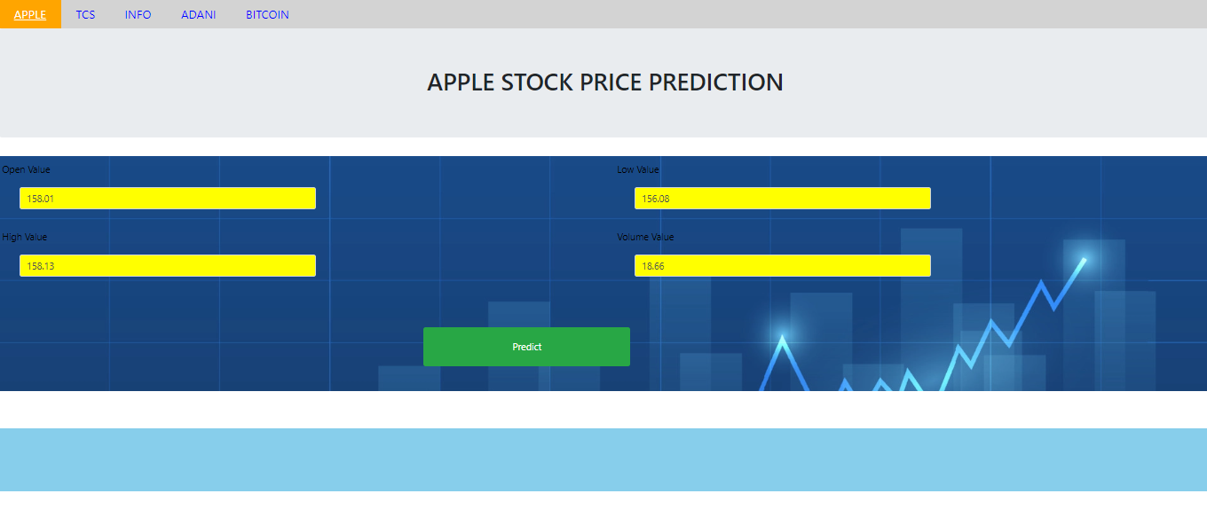
SCREEN SHOTS
INPUT:

Slide 25
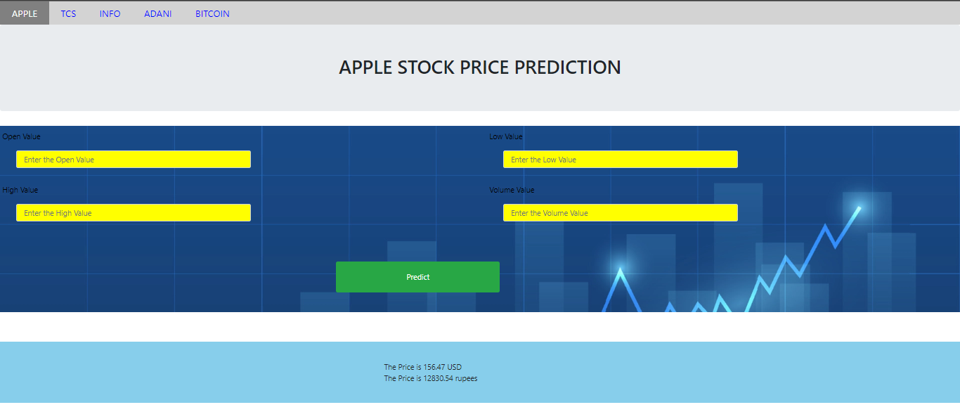
SCREEN SHOTS(contd..)
OUTPUT FOR APPLE :

Slide 26
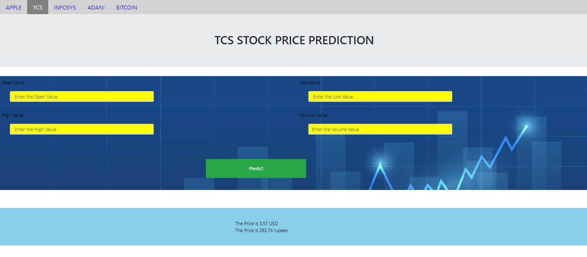
SCREEN SHOTS(contd..)
OUTPUT FOR TCS:

Slide 27
CONCLUSION & FEATURE ENHANCEMENT
CONCLUSION:
The analytical process started from data cleaning and processing, missing value, exploratory analysis and finally model building and evaluation. The Best accuracy on public test set is higher accuracy score is will be find out. This application can help out to find the stock price of the data.
FUTURE WORK:
To optimize the work to implement in Artificial Intelligence Environment.
Connect it with IOT.

Slide 28
REFERENCES
[1] Raymond Chiong , Zongwen Fan, Zhongyi Hu, and Sandeep Dhakal, “A Novel Ensemble Learning Approach for Stock Market Prediction Based on Sentiment Analysis and the Sliding Window Method ”, IEEE,2022.
[2] Haocheng Du “Research on Amazon’s stock price forecasting based on arbitrage pricing model based on big data” 2022.
[3] Shreya Pawaskar, “Stock Price Prediction using Machine Learning Algorithms”,International Journal for Research in Applied Science & Engineering Technology, 2022.
[4] Theyazn H. H. Aldhyani Ali Alzahrani, “Framework for Predicting and Modeling Stock Market Prices Based on Deep Learning Algorithms”, Electronics journals,2022.
[5] Dr. Poorna Shankar, Dr. Neha Sharma, Mr. Roushan Raj and Mr. Chetan Dalwadi; “Stock Price Prediction Using LSTM, ARIMA and UCM”,Journal of Development Economics and Management Research Studies,2022.
[6] Milon Biswas, Arafat Jahan Nova, Md. Kawsher Mahbub, Sudipto Chaki, and Shamim Ahmed, Md. Ashraful Islam, “Stock Market Prediction: A Survey and Evaluation”,IEEE,2021.

Slide 29
REFERENCES(contd..)
[7]Shubha Singh,Sreedevi Gutta and Ahmed, “Stock Prediction Using Machine Learning”, WSEAS Transactions on computer research,2021.
[8] C. C. Emioma, and S. O. Edeki, “Stock price prediction using machine learning on least-squares linear regression basis”,Journal of Physics, 2021.
[9] Sidra Mehtab, Jaydip Sen and Abhishek Dutta, “Stock Price Prediction Using Machine Learning and LSTM-Based Deep Learning Models”, IEEE,2021.
[10] Nusrat Rouf, Majid Bashir Malik, Tasleem Arif, Sparsh Sharma, Saurabh Singh, Satyabrata Aich, and Hee-Cheol Kim, “Stock Market Prediction Using Machine Learning Techniques: A Decade Survey on Methodologies, Recent Developments, and Future Directions ”, Electronics journals,2021.
[11] A M Pranav, Sujooda S, Jerin Babu, and Amal Chandran,Anoop , “StockClue: Stock Prediction using Machine Learning”,International Journal of Engineering Research & Technology,2021.
[12] Kevin Thomas, “Time Series Prediction for Stock Price and Opioid Incident Location”,IEEE,2019.

